Slide 1
Computer Forensics with Image Processing and Steganography
Presenters:
Betrand Nnamdi 200392263
Chao Zhang 200383834
Supervised by: Dr. Habib Louafi

Slide 2

1
Introduction
outline
2
Background
3
Computer Forensics
4
Image Processing
5
Steganography
6
Implementation
7
Conclusion & Future Research

Slide 3
1 Introduction
A computer solves problems, stores data and retrieves data.
Forensics involves using different processes and methods to gather
evidence and solve crimes.
First computer forensic technicians were law enforcement officers who
were also computer hobbyists.
First crime cases involving computers were recorded in the 1970s. These
were mainly financial fraud.

Slide 4
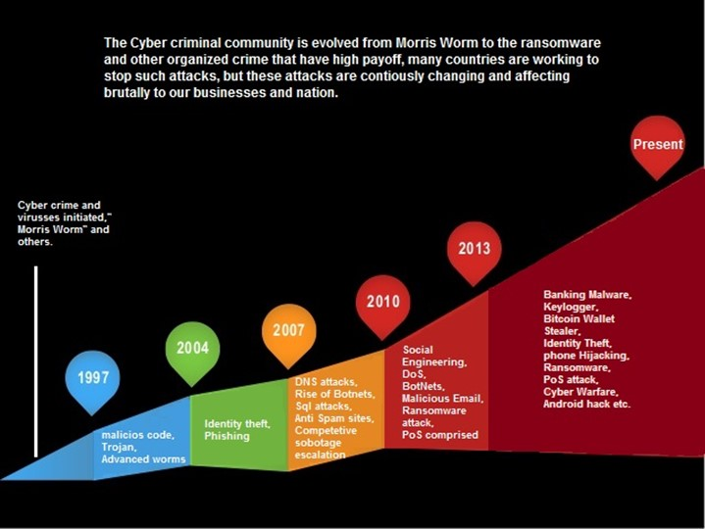
2 Background
Evolution of cyber attacks:
[https://www.itbusinessedge.com/slideshows/the-evolution-of-cyber-attacks-02.html]

Slide 5

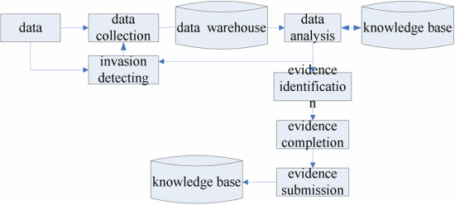
3 Computer Forensics
Obtain evidence -> Identify evidence -> Analyze evidence
Widely used by law enforcement in cases of cybercrime
and other illegal activities.
Media examined can include hard drives, mobile phones
etc.
Unless the media is completely destroyed physically,
some information can usually still be recovered.

Slide 6
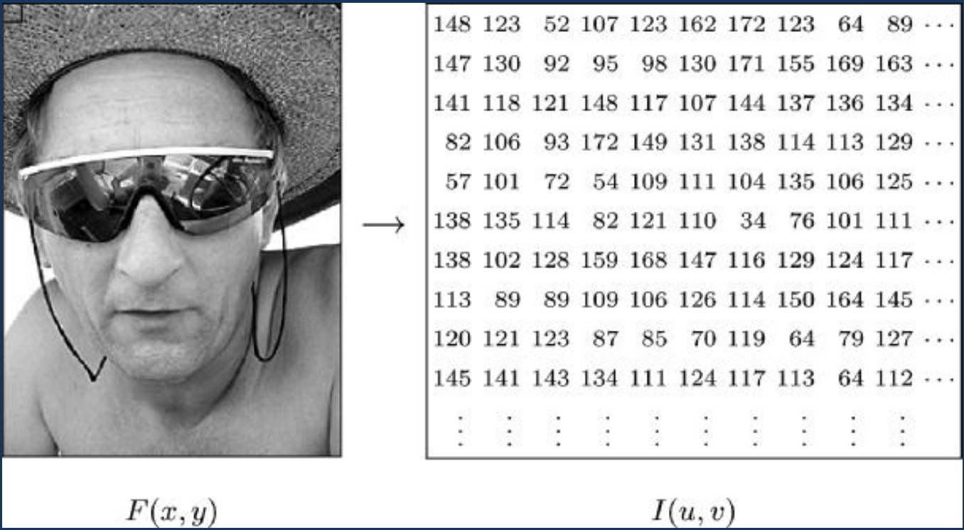
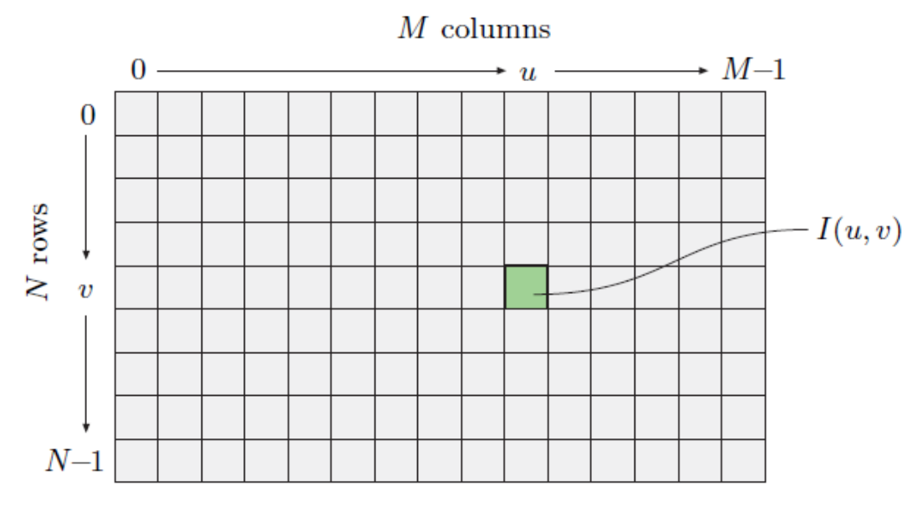
4 Image Processing
Involves performing some operations on an image
To change its visual appearance
Extract information from the image
A computer image is made up of pixels
A pixel is made of 3 color components (RGB)

Slide 7
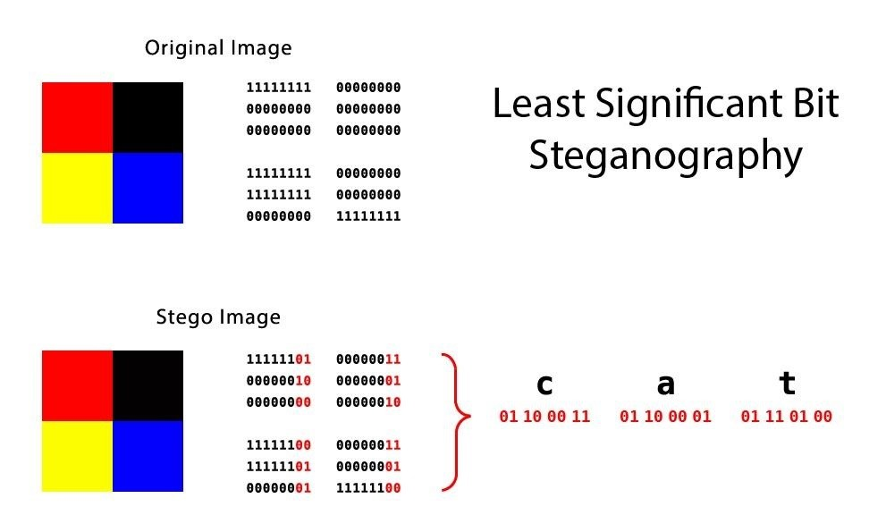
5 Steganography
Steganography is used to hide secret data within a non-secret file, image or message.
The data is often encrypted for added protection.
A common use of steganography is watermarking.
[https://null-byte.wonderhowto.com/how-to/steganography-hide-secret-data-inside-image-audio-file-seconds-0180936/]

Slide 8
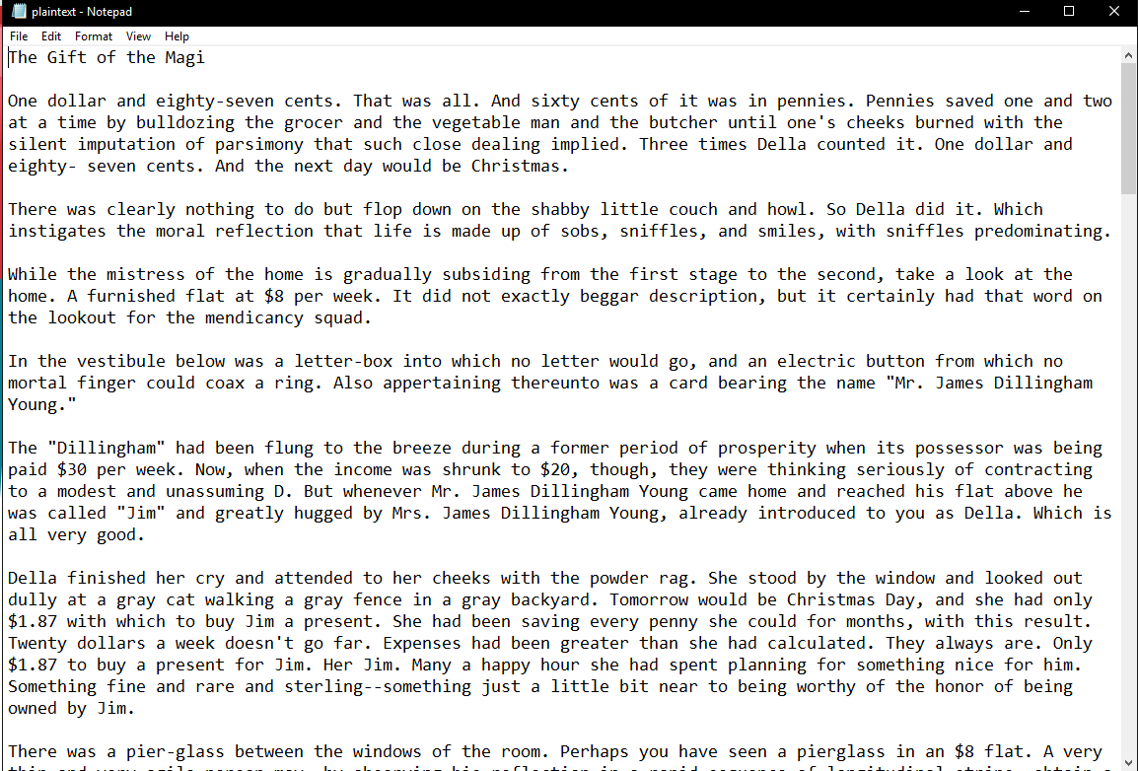

6 Implementation
Demo (Symmetric Encryption):
Plaintext: A short story of O'Henry: The gift of magi
Secret key: An image of a cat
Numbers of the character in plaintext: 11208
The type of the image: uint8
The shape of the image: (4032, 3024, 3)
The size of the image: 36578304

Slide 9
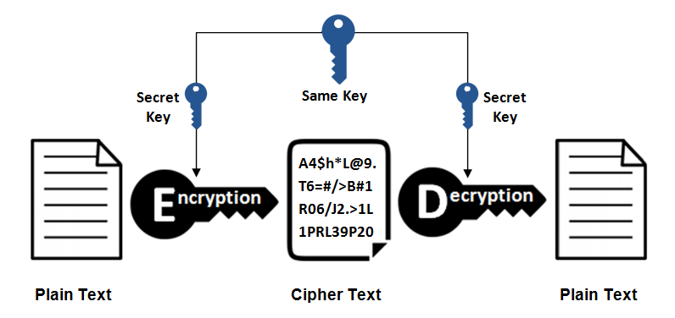

6 Implementation
Structure: Symmetric Encrytopn

Slide 10
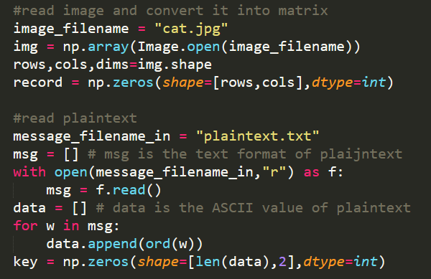
6 Implementation
Set up:

Slide 11
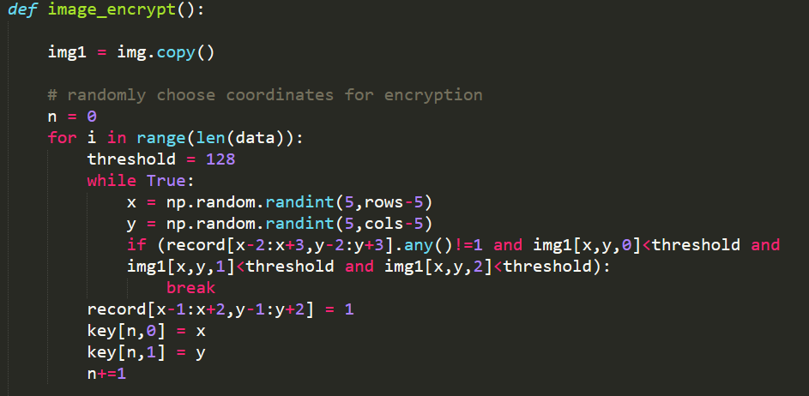
6 Implementation
Encryption:

Slide 12
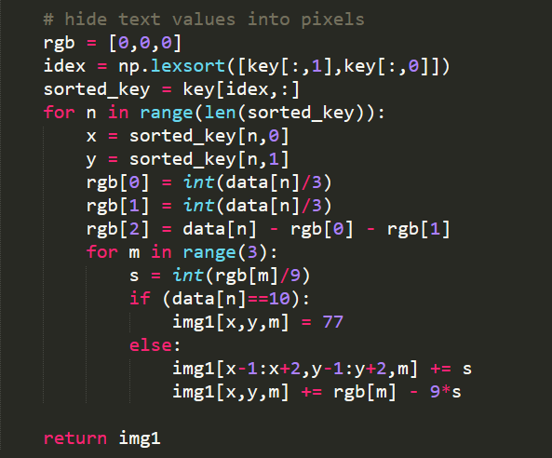
6 Implementation
Encryption:

Slide 13
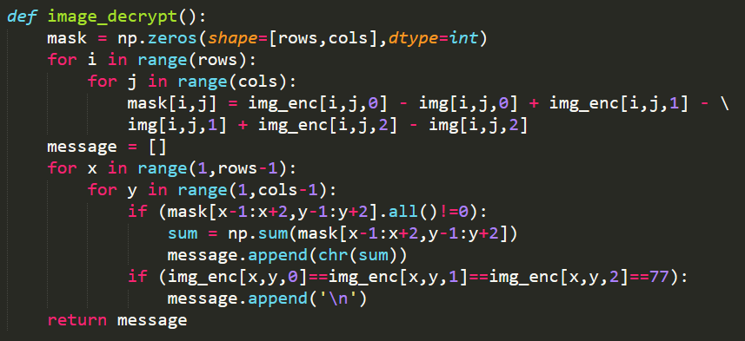
6 Implementation
Decryption:

Slide 14
7 Conclusion & Future Research
▫▫▫▫Now▫▫▫▫
▫The concept of computer forensics
▫The concept of image processing
▫Basic operations of steganography
▫Practical implementation
▪▪▪Future▪▪▪
▪Improve the integrity
▪Increase the efficiency
▪Compare it with other algorithms to modify some functions

